Slide 1


Slide 2
Before we start
Make sure that you are sitting correctly.
Turn on the lights.
Get ready with your Student’s Books, notebooks and pens.
Write in the chart!
Connect us please!

Slide 3
What’s the date today?
Today is…
The 13th of April.

Slide 4
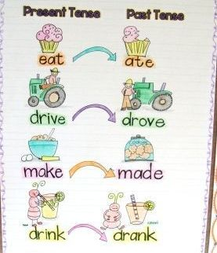
What can you see in this picture?

Slide 5
Let’s remember the words: Listen and repeat
[Ʌ] become
[ɒ] got
[ɪ] begin, drink, give, sit, did
[e] get, set, went, read (2nd form),
[ɪ:] be, see, eat, read (1st form), meet
[ʋ:] do, took
[ɔ:] was, saw, bought
[ɜ:] were
[ju:] grew, flew, knew
[æ] have, had, ate, began, drank
[Əu] go, grow, know
[e ɪ] take, make, became, made, gave
[a ɪ] fly, buy

Slide 6
How do you know the 2 forms of the irregular verbs?
Connect us,
listen to the verbs in Russian and name in English the 2 forms of the verbs.
The others write them in the chart.

Slide 7


Slide 8
SB: p. 110, №1
Match the 1st and the 2nd forms of the verbs

Slide 9
Check yourself
Draw – drew
Make – made
Eat – ate
Drink – drank
Sing- sang
Leave – left
Write – wrote
Buy- bought
Give - gave
Писать Петь Рисовать Покидать, оставлять Покупать Пить Давать Есть делать

Slide 10
Gymnastics
1. Don’t look at the monitor
2. Close your eyes
3. Count to 5
4. Open your eyes
5. Stand up
6. Hands up
7. Hands down.
8. Hands to the sides
9. Sit down
10. Move your head and look up, look down, look left, look right.

Slide 11
SB: p. 110, №2
What Paco didn’t do yesterday?
He bought a jacket.
He ate a sandwich
He sang a song.
He wrote a letter.
He made the decorations.
He drew a picture.

Slide 12
Grammar
При образовании отрицательных и вопросительных предложений в Past Simple с неправильными глаголами следует применять то же правило, что и для правильных глаголов.
Какое это правило?
+ -
He sang a song. He didn’t sing a song
He made the decorations. He didn’t make the …

Slide 13
???
Your questions

Slide 14
HOMEWORK
Повторять записанные неправильные глаголы.
Учебник: с. 107 прочитать историю и вставить информацию в пропуски.
Сборник упражнений: с.99-101, №1-4

