Slide 1



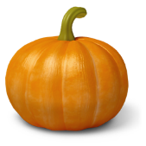

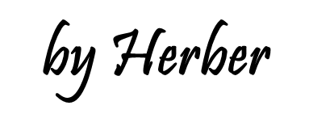

Slide 2
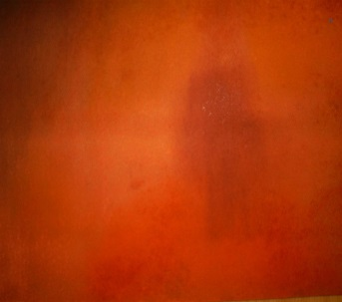
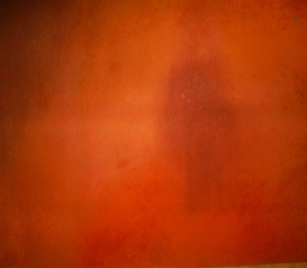



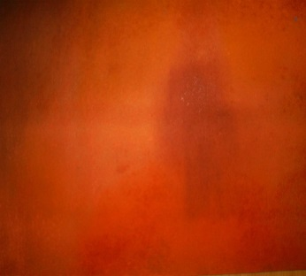




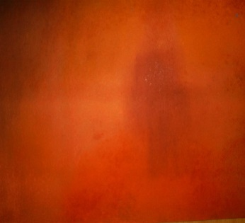




1/5
It’s a turkey
What’s the hidden picture?
NEXT
CHECK

Slide 3



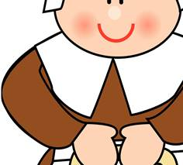





2/5
They’re pilgrims
What’s the hidden picture?
NEXT
CHECK

Slide 4




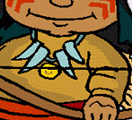
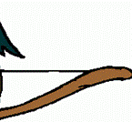



3/5
He is an American native
What’s the hidden picture?
NEXT
CHECK

Slide 5
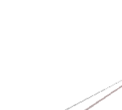
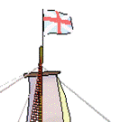
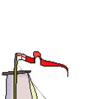
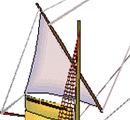
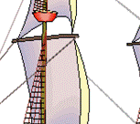
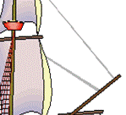


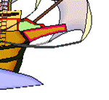
4/5
It’s the Mayflower
What’s the hidden picture?
NEXT
CHECK

Slide 6









5/5
It’s a pumpkin
What’s the hidden picture?
NEXT
CHECK

Slide 7


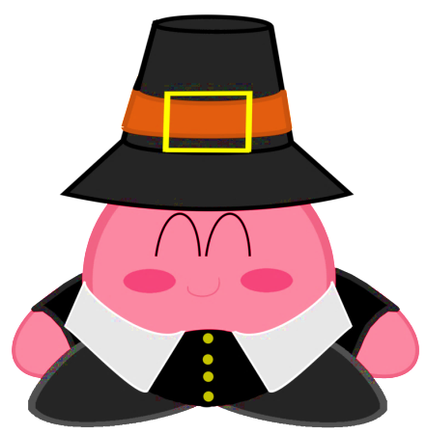
pilgrim
Click on the right picture
1/8
NEXT

Slide 8



hat
Click on the right picture
2/8
NEXT

Slide 9


American native
Click on the right picture
3/8
NEXT

Slide 10



turkey
Click on the right picture
4/8
NEXT

Slide 11
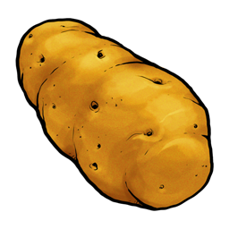

pumpkin
Click on the right picture
5/8
NEXT

Slide 12

corn
Click on the right picture
6/8
NEXT

Slide 13
potato
Click on the right picture
7/8
NEXT

Slide 14


pumpkin pie
Click on the right picture
8/8
NEXT

Slide 15

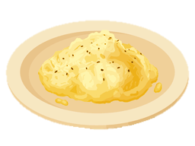

mashed potatoes
apple pie
cranberry sauce
1/6
Click on the right option
NEXT

Slide 16

cranberry sauce
gravy
tomato sauce
2/6
Click on the right option
NEXT

Slide 17
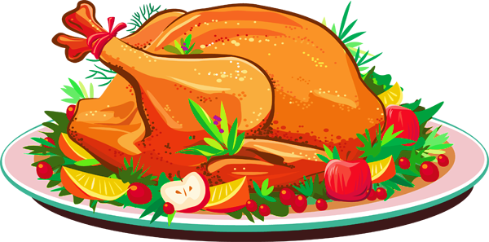
chicken
turkey
duck
3/6
Click on the right option
NEXT

Slide 18
cauliflower
artichoke
corn
4/6
Click on the right option
NEXT

Slide 19
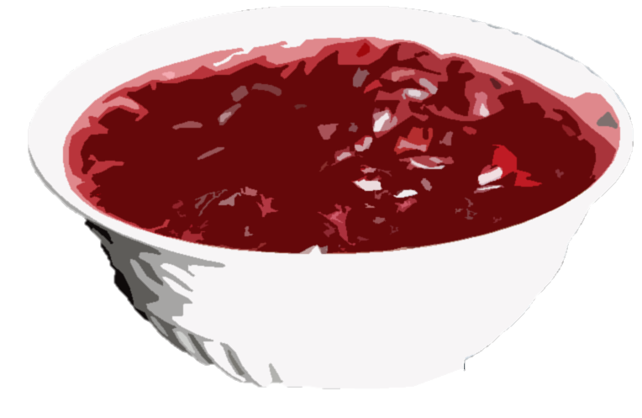
cranberry sauce
cranberry cake
strawberry sauce
5/6
Click on the right option
NEXT

Slide 20
apple pie
cheese cake
pumpkin pie
6/6
Click on the right option
NEXT

Slide 21
Find out 9 words related to Thanksgiving Day
T
N
O
V
E
M
B
E
R
H
F
H
A
U
T
U
M
N
U
A
P
P
R
E
Y
A
D
R
M
O
A
H
I
T
E
I
S
I
T
R
S
C
P
A
N
D
L
A
A
W
O
K
P
N
A
Y
T
D
Z
R
O
I
E
Y
R
O
E
A
N
F
E
R
CHECK
TIME’S UP

Slide 22
T
N
O
V
E
M
B
E
R
H
F
H
A
U
T
U
M
N
U
A
P
P
R
E
Y
A
D
R
M
O
A
H
I
T
E
I
S
I
T
R
S
C
P
A
N
D
L
A
A
W
O
K
P
N
A
Y
T
D
Z
R
O
I
E
Y
R
O
E
A
N
F
E
R
NEXT
Make some sentences with the words

Slide 23
Thanksgiving Day is in Autumn.
It’s on the fourth Thursday of November
Families have a big dinner on Thanksgiving.
They have turkey, corn, potatoes, and pumpkin pie.
There is a big parade in New York City.
NEXT

Slide 24

What are you thankful for?
Say five things you are thankful for
NEXT

Slide 25


EXIT

