Slide 1
Grammar practice

Slide 2
Before we start
Make sure that you are sitting correctly.
Turn on the lights.
Get ready with your Student’s Books, notebooks and pens.

Slide 3
Let’s remember basic rules
Countable nouns | Uncountable nouns

Slide 4
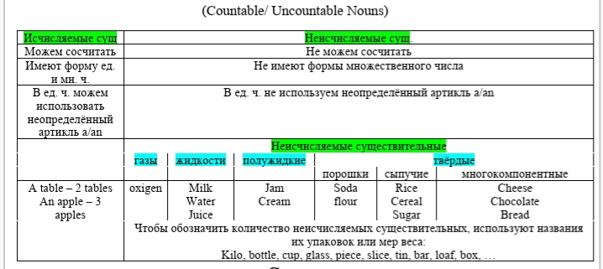

Slide 5
Let’s remember basic rules
Some | Any

Slide 6
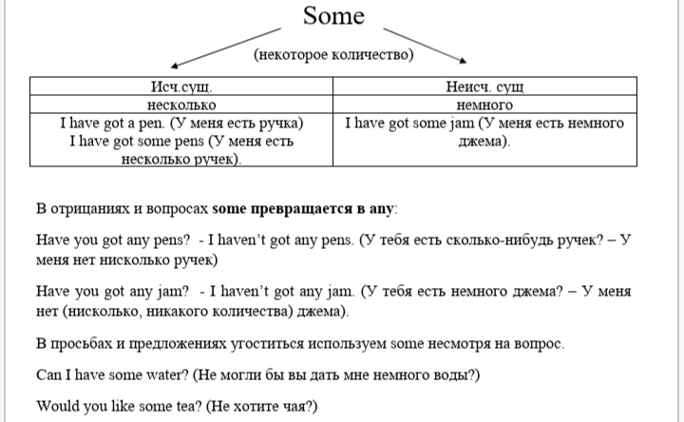

Slide 7
Let’s remember basic rules
Many/much/ a lot of/ (a)few/(a)little

Slide 8
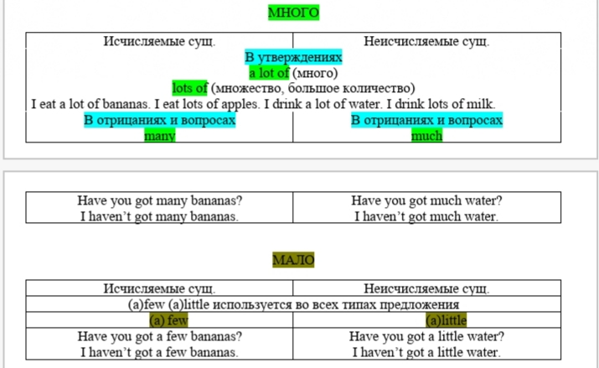

Slide 9
Let’s check your home assignment
WB p 63 ex 1,2,3

Slide 10
key:
Ex. 1:
1 a)
2 There is some cheese on the breakfast tray.
3 There is some bread on the breakfast tray.
4 There are some nuts on the breakfast tray.
b)
2 There are some olives in the pizza.
3 There is an onion in the pizza.
4 There is a pepper in the pizza.

Slide 11
key:
Ex 2
Ingredients:
milk, chocolate, eggs, sugar, butter
You need some chocolate.
You need some eggs.
You need some sugar.
You need some butter.

Slide 12
key:
Ex. 3
2 How many bananas do you want? Five bananas.
3 How much olive oil do you want? Four bottles of olive oil.
4 How many tomatoes do you want? Three toma& toes.
5 How much bread do you want? A loaf of bread.
6 How many biscuits do you want? Four biscuits.

Slide 13
Progress check
SB p 104 ex. 1-6

Slide 14
Let’s do the test
https://pruffme.com/landing/u1392075/tmp1585812901

Slide 15
Home assignment
WB p 64 ex 5
Списать слова 9 модуля в словари
Выслать фото словаря до 17 часов вечера субботы, 18 апреля

