Slide 1


Slide 2

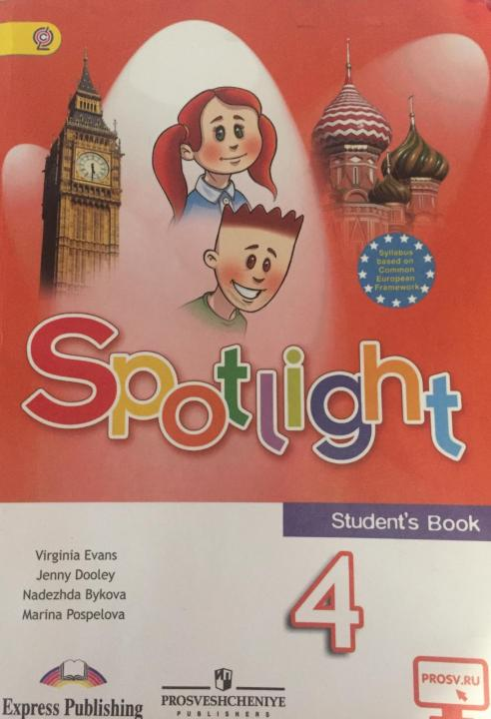

Before we start
Make sure that you are sitting correctly.
Turn on the lights.
Get ready with your Student’s Books, notebooks, exercise books and pens.

Slide 3
What’s the date today?
Today is…
The 20th of April.

Slide 4

Let’s check your homework

Slide 5
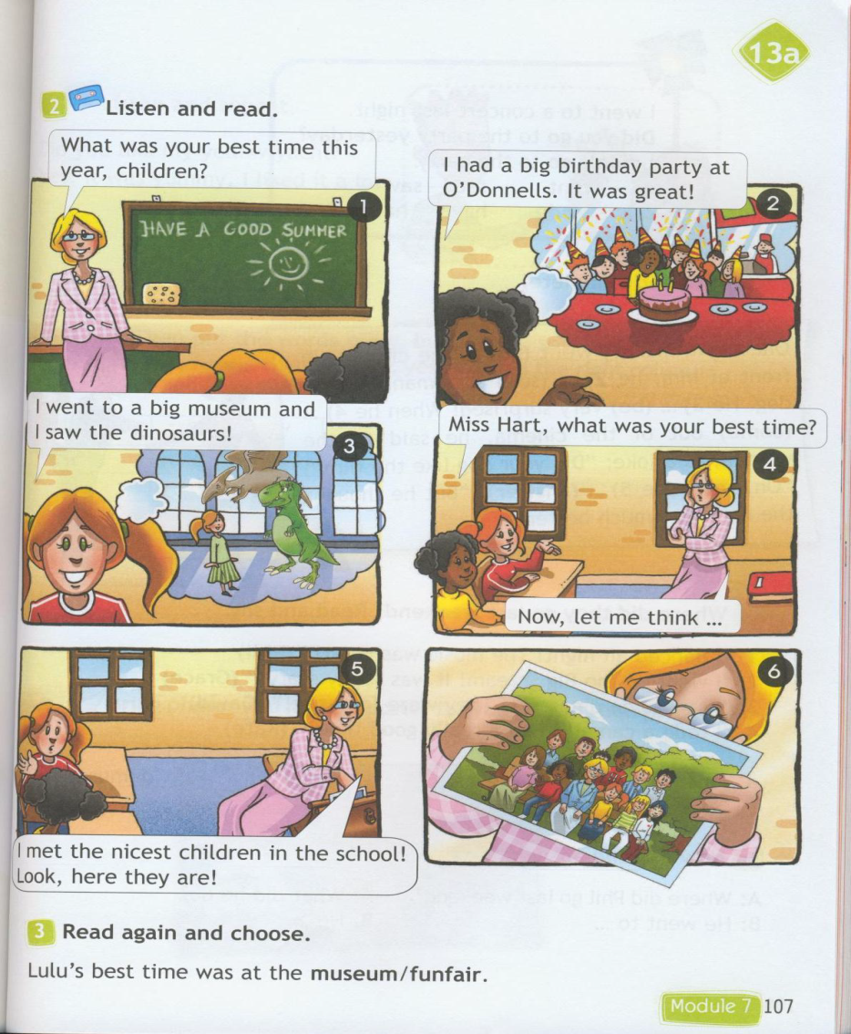
Student’s book p.107

Slide 6
Прочитайте полный текст и дополните недостающей информацией, используя с.107 в учебнике.
The school finished. At the last lesson
Lulu’s teacher Miss Hart asked her pupils about
their best time during the school year.
Maya said that she had _________________________. Lulu remembered her visit to the _________, where she saw _____________. She liked ___________.
Then the children asked Miss Hart about her ________________________. She thought a little, than she said that she ________________________.

Slide 7
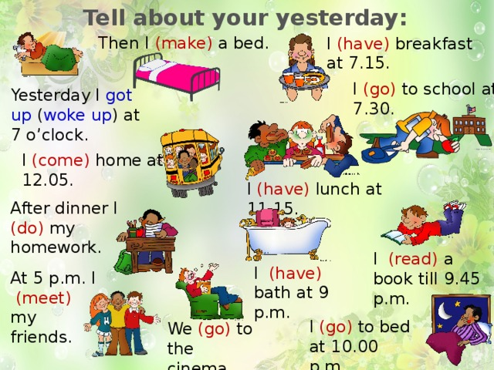
Let’s listen your stories!
What day did you have yesterday

Slide 8
Gymnastics
1. Don’t look at the monitor
2. Close your eyes
3. Count to 5
4. Open your eyes
5. Stand up
6. Hands up
7. Hands down.
8. Hands to the sides
9. Sit down
10. Move your head and look up, look down, look left, look right.

Slide 9
Exercise book p.99-101
Have you got any questions?

Slide 10
Degrees of comparison
Степени сравнения прилагательных
Какие 3 степени сравнения существуют? (положительная (какой?), сравнительная (более чем), превосходная (самый))
Как образуется превосходная степень?
Для прилагательных с 1 или 2 слогами:
Clever -> the cleverest; big -> the biggest; pretty -> the prettiest
Для прилагательных с 3мя и более слогами:
Beautiful -> the most beautiful; interesting -> the most interesting.
*Исключения:
Good – the best; bad – the worst; little – the least; many/much – the most

Slide 12
???
Your questions

Slide 13
HOMEWORK
Повторять записанные неправильные глаголы.
Знать правило степеней сравнения прилагательных.
Сборник упражнений: с.102-103, №7-10
Выслать на проверку задания из сборника!

