Slide 1
Travel & Leisure
Unit 10 Lesson 10a
УМК Ю.Е. Ваулиной, Дж. Дули,
О.Е. Подоляко, В. Эванс «Spotlight» для 5 класса общеобразовательных учреждений
Автор
Рекомендации
Ресурсы

Slide 2

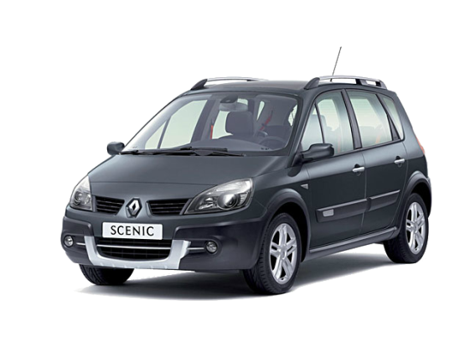
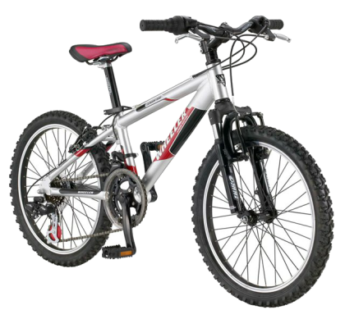
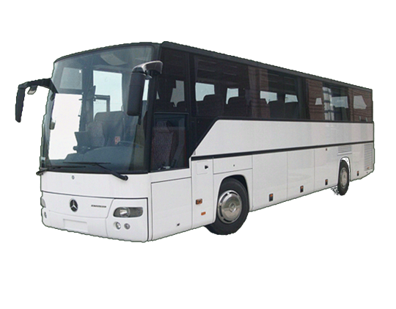
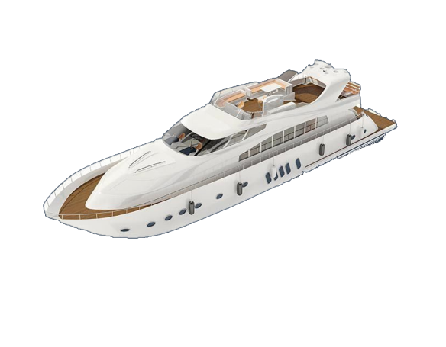
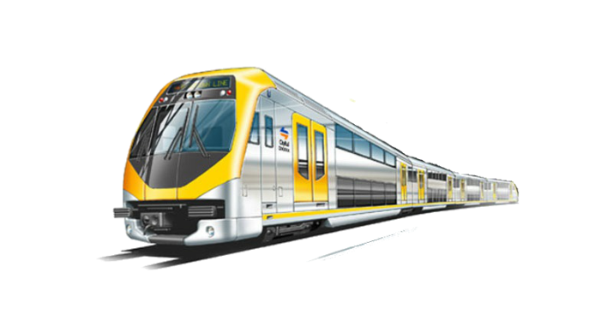
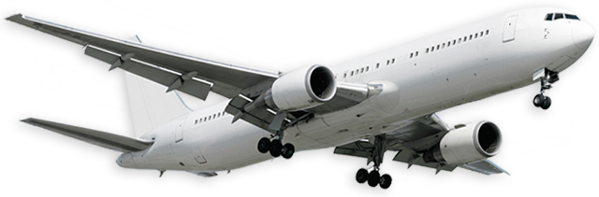
Answer the question
What’s this?
It’s a … .
Start
Skip

Slide 3
a car
a plane
a bus
1
2
3
4
5
6
F
I
N
I
S
H
a bicycle
a train
a ship

Slide 4

a car
a plane
a bus
1
2
3
4
5
6
F
I
N
I
S
H
a bicycle
a train
a ship

Slide 5

a car
a plane
a bus
1
2
3
4
5
6
F
I
N
I
S
H
a bicycle
a train
a ship

Slide 6

a car
a plane
a bus
1
2
3
4
5
6
F
I
N
I
S
H
a bicycle
a train
a ship

Slide 7
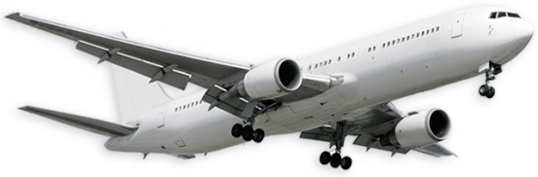
a car
a plane
a bus
1
2
3
4
5
6
F
I
N
I
S
H
a bicycle
a train
a ship

Slide 8
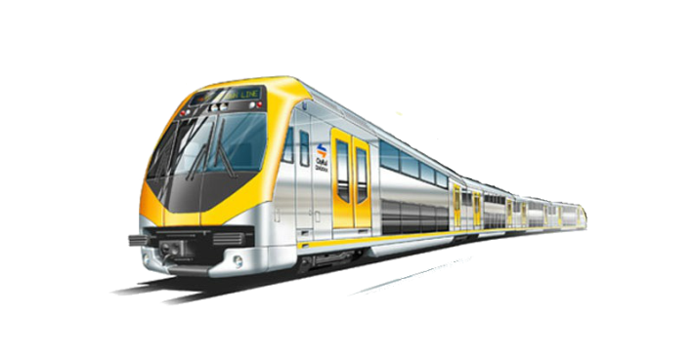
a car
a plane
a bus
1
2
3
4
5
6
F
I
N
I
S
H
a bicycle
a train
a ship

Slide 9
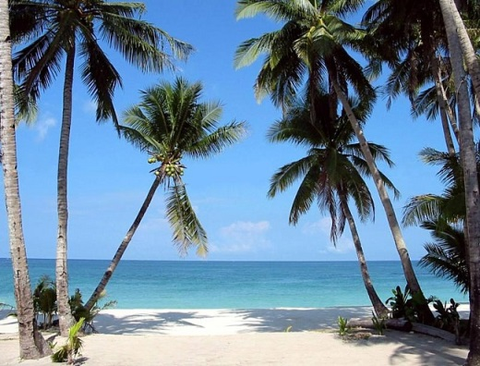
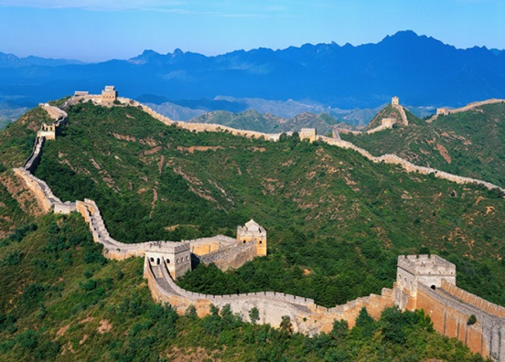
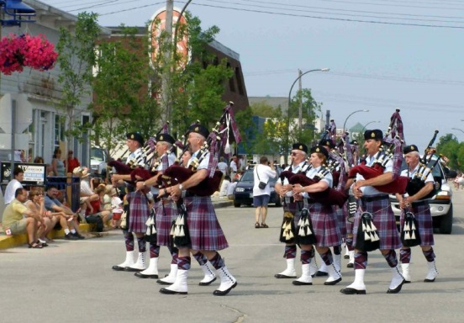
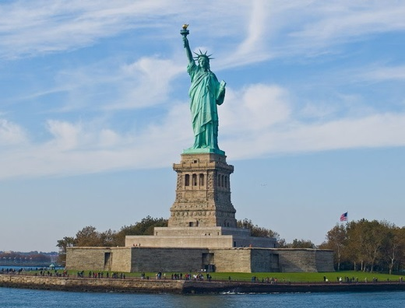
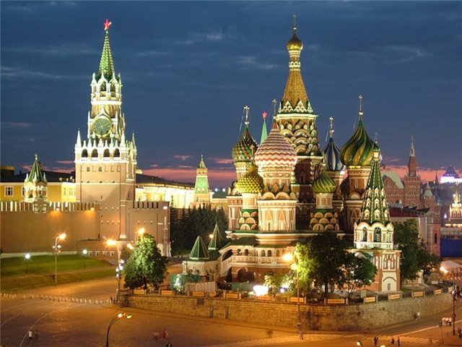
Guess and say the meaning of the idiom
Travel broadens the mind.
Путешествие расширяет кругозор.

Slide 10
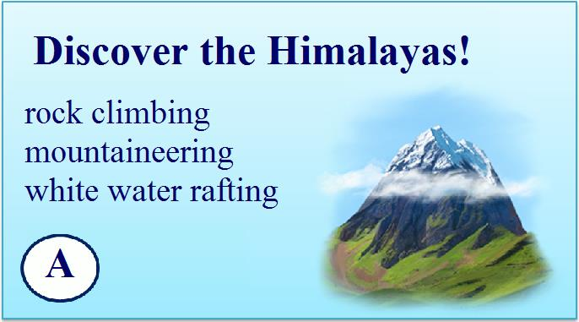



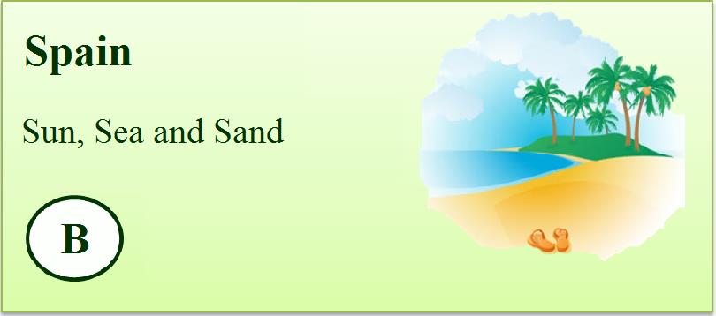
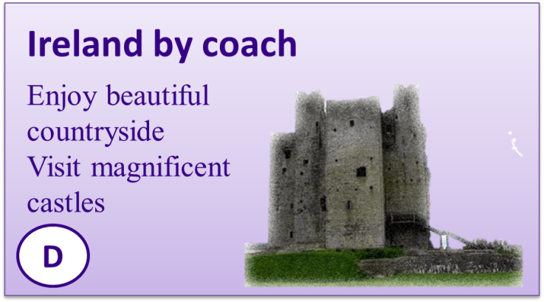




Match the type of holiday to the advert

Slide 11





Listen to and read the adverts and find:
apartments, camps
two places to stay
rock climbing, mountaineering, trekking
three activities
coach, cruise ship
two means of transport
Spain, Egypt, Ireland
three countries

Slide 12




Match the people to the holidays
Ann and Tony want to have a good rest.
John likes to do extreme sports.
Amy wants to see animals.
Stella likes to learn about ancient culture.
Mikes loves to see green countryside.

Slide 13
Act out the talk
You are a travel agent. Your partner (client) wants to spend his/her holidays abroad. Use the information in the adverts to advise him/her.
A: I’d like to travel abroad this summer.
B: Why don’t you go to the Himalayas?
A: The Himalayas? What can you do there?
B: Well, there's a lot to see. For example, you can...

Slide 14


Read the grammar box
Can for something allowed or possible.
You can buy souvenirs here.
(it is possible, you
are allowed)
Can’t for
something not allowed.
You can’t smoke here.
(it isn’t allowed).

Slide 15
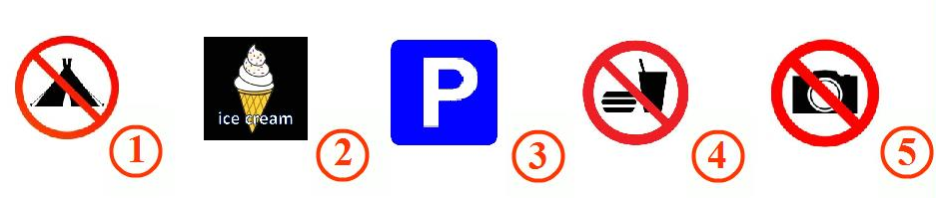
Match the signs (1-5) to the meanings (a-e)
A | 4 | You can’t eat or drink.
B | 2 | You can buy ice creams.
C | 5 | You can’t take photographs.
D | 3 | You can park here.
E | 1 | You can’t camp.

Slide 16

Listen to someone booking a ticket by phone and fill in the missing information
Name: Harry
Place: 1) ……………….
Date/leave: 2) ..………… July
Date/come back: 3) ………………. August
Travel by: 4) ………………
Price: 5) …………………
Smith
Ireland
28th
4th
coach
£300

Slide 17

Answer the questions
What did we do?
What did we learn?
What was difficult?
Did you like our lesson?

Slide 18
Homework
Базовый
WB p.71
SB ex.9 p.117: Make holiday adverts for places in your country. Use the adverts in ex.1 as models. Illustrate your adverts.
Повышенный
Базовый + ex. 9. Record yourself.

Slide 19
Resources
Английский язык, 5 класс: учеб. для общеобразоват. учреждений/[Ю.Е.Ваулиной, Дж.Дули, О.Е. Подоляко, В. Эванс] - 3-е изд., доп. и перераб. - М.:Express Publishing: Просвещение, 2009. - 164с.:ил.
Аудиоприложение к учебнику Ю.Е. Ваулиной, Дж. Дули, О.Е. Подоляко, В. Эванс - 3-е изд., доп. и перераб. - М.: Express Publishing: Просвещение, 2009
http://img7.autonavigator.ru/carsfoto/1600/1535/51967/Renault_Scenic%20Conquest_Minivan_2008.jpg – машина
http://www.s-p-e-c.ru/files/flib/33.gif - автобус
http://www.phoenixengsys.com/media/homepage/train-1.jpg - поезд
http://clariche.ru/wp-content/uploads/2012/01/hyosung_gt_650_s_2005_1600.jpg - мотоцикл
http://cgresource.net/uploads/download/ships/thumbs/1252163605_wt_20.jpg - корабль
http://inspire-green.com/images/plane.png - самолет
http://im1.asset.yvimg.kz/userimages/biopsihoz/N9hCd50t05cQYTBFXOE4ZgCmgJ51km.gif - идущий человек
http://www.velobomba.ru/uploads/image/JUNIOR%20200.jpg – велосипед
http://www.photokonkurs.com/uploads/img/2007-01-04/SOLDIERS/98640.jpg – шотландцы
http://co12.nevseoboi.com.ua/wallpapers/nature/1347903852-307302-0274202_www.nevseoboi.com.ua.jpg - пляж
http://wiki.iteach.ru/images/8/8e/Welcome_to_Russia!.jpg – красная площадь
http://www.zhaba.ru/_pics/u2g7fcxf9rkh2zda.jpg - великая китайская стена
http://kolizej.at.ua/_pu/4/64780291.jpg - статуя свободы.

Slide 20
Resources
Back
http://www.matorin-un.ru/upload/medialibrary/399/zlar2.png - горы
http://static.freepik.com/free-photo/tropical-beach_93468.jpg - пляж
http://www.art-saloon.ru/big/item_5461.jpg - пирамида
http://eputevka.kiev.ua/images/luchshie-oteli-irlandii-gorod-trim-putevoditel_1.gif - замок
http://littlebluezebra.com/assets/jpg/GiraffeFaq.jpg - жираф
http://www.3danimationsoftwaretips.com/wp-content/uploads/2011/11/108512866.jpg - человечек
http://pictures.ese.co.uk/images/product/large/2344.jpg - no eating or drinking
http://drivecar.com.ua/skin/images/pdd/zn_5_38.gif - парковка
http://www.proshkolu.ru/content/media/pic/std/2000000/1089000/1088648-7f13811e9ef65a5a.jpg - не фотографировать
http://jeffatwood.typepad.com/atwoodzoo/images/menu_ice_cream_cone.jpg - мороженое
http://us.cdn4.123rf.com/168nwm/_fla/_fla1206/_fla120600487/14169770-no-camping-sign.jpg - no camping
http://www.prazdnik-az.ru/images/ballons/18.jpg – скрипичный ключ
http://www.koipkro.kostroma.ru/BuyR/ChBor/ych/13/ucheniki_w450_h468.jpg - ученики за партой
http://englishon-line.ru/grammatika-spravochnik28.html - звуки транскрипции
http://goanimate.com/videos/01DHC8qe6FeA?utm_source=linkshare&utm_medium=linkshare&utm_campaign=usercontent - мультфильм

Slide 21
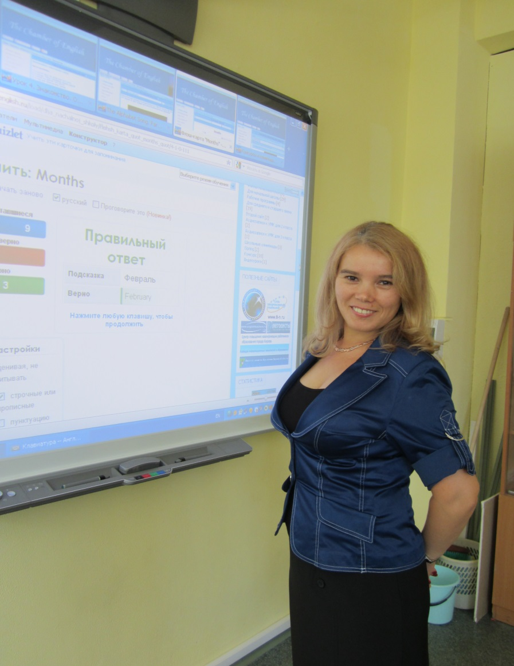
Author
Back
Полушкина Гульчачак Форзановна,
учитель английского языка
КОГОАУ «Лицей естественных наук»,
преподаватель Института развития образования Кировской области
gpolushkina@mail.ru
www.pgfenglish.ru
www.klen-students.blogspot.ru

Slide 22
Рекомендации
Back
Конспект
Методические рекомендации

Slide 23
Спасибо за внимание!

