Slide 1


Slide 2



Before we start
Make sure that you are sitting correctly.
Turn on the lights.
Get ready with your Student’s Books, notebooks, exercise books and pens.

Slide 3
What’s the date today?
Today is…
The 18th of May.

Slide 4

What is the weather like today?
It’s … and …

Slide 5

What will the weather be like tomorrow?
It will be …

Slide 6
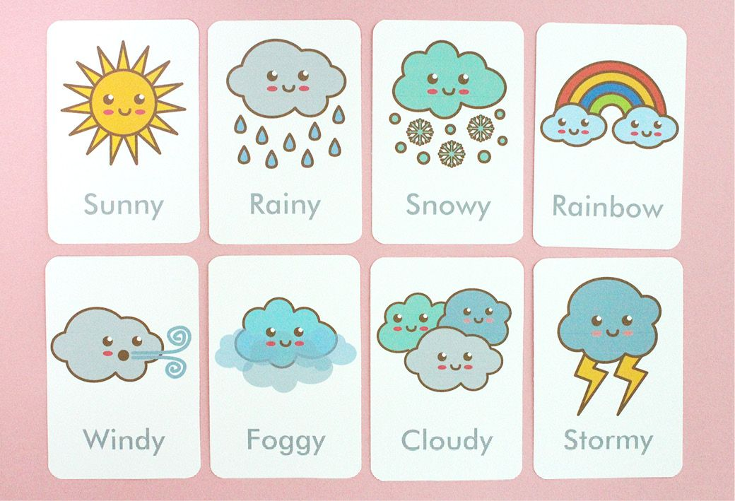
What are we going to speak about at our lesson today?
We are going to speak about…

Slide 7

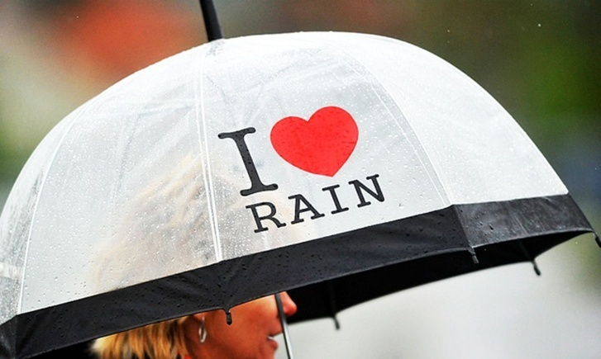
English people like to speak about weather very much.
Why?

Slide 8
[ɪ] wind, windy, chilly
[Ʌ] sun, sunny, thunder, thunderstorm
[ɔ ] cold, hot, fog, foggy, frost, frosty
Let’s revise the words

Slide 9
[ɪ :] sleet, sleety, freezing
[ɔ:] storm, stormy, warm
Let’s revise the words

Slide 10
[ei] rain, rainy, rainbow
[ai] lightning, icy
[əʊ] snow, snowy, snowfall
[aʊ] cloud, cloudy, cloudless
Let’s revise the words

Slide 11
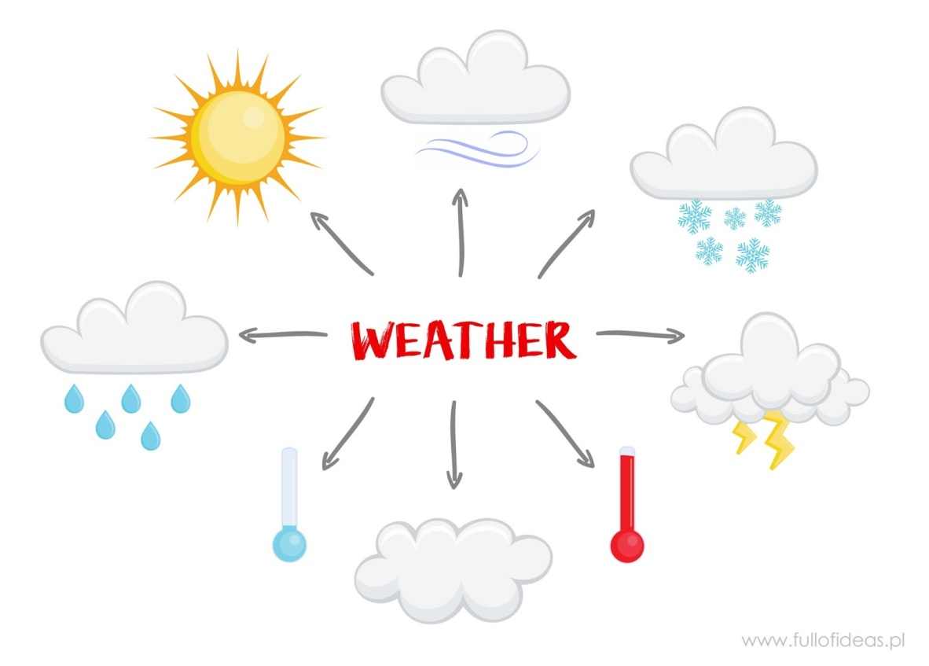
Какую часть речи нам нужно использовать, чтобы правильно рассказать о погоде?

Slide 12
Прилагательные с суфиксом y
(сущ.(основа) + y = прилагательное.)

Slide 13
It’s a cold/hot/warm/chilly day.
It’s so cloudy/hot/sunny today, isn’t it?
What a nice/fine/day!
Such a wonderful weather!
Such a terrible weather!
Phrases to say about weather

Slide 14
Gymnastics
1. Don’t look at the monitor
2. Close your eyes
3. Count to 5
4. Open your eyes
5. Stand up
6. Hands up
7. Hands down.
8. Hands to the sides
9. Sit down
10. Move your head and look up, look down, look left, look right.

Slide 15
Now let’s make some sentences about the weather
Put the words in the right order to make a sentence

Slide 16
It be
sunny
won’t
in
the evening

Slide 17
will tomorrow
rainy
It
in
Athens
be

Slide 18
Moscow be
the like
What
in
weather
this summer?

Slide 19
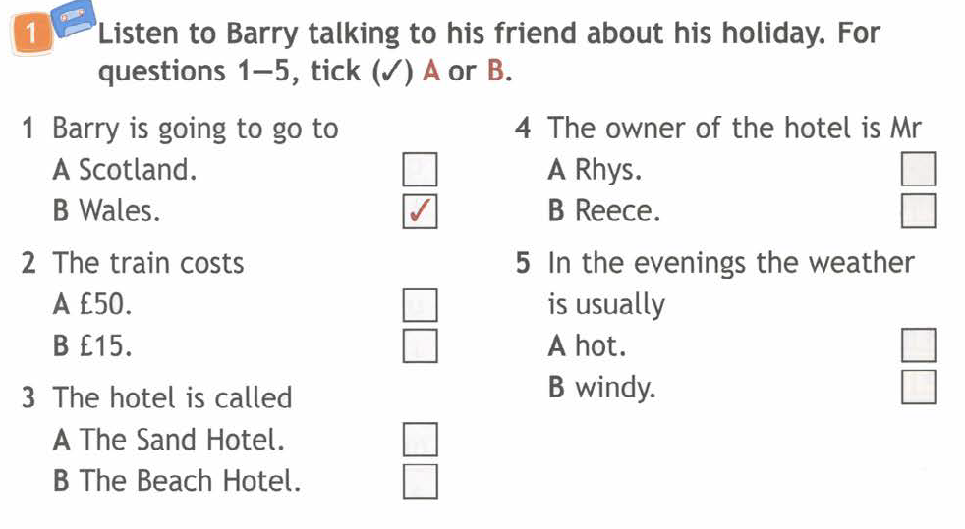
Let’s listen to Barry and his friend. What are they talking about?

Slide 20
HOMEWORK
Презентация: выписать новые слова по теме погода с переводом
Учебник: с.126, №1, прослушать аудиозапись (см. в материалах к уроку), выписать слова с переводом.
Учебник: с.127, №4 прочитать и выполнить задание.
Выслать на проверку ничего не нужно.

