Slide 1


Slide 2
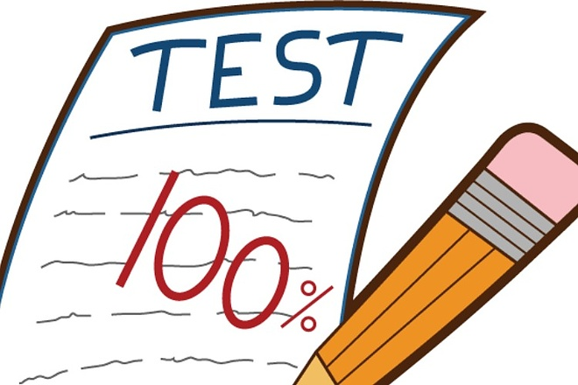
We are going to prepare for the test

Slide 3
Read the short texts. What are they about?
My mother is a doctor. My father is a teacher. I’ve got a younger sister. She is six. In summer we go to my Granny’s village.
Yesterday we went to the Zoo and I saw a kangaroo there. Its front legs are short and its back legs are long. Kangaroos can run very quickly.
I like summer. I like swimming and playing football. I don’t like winter because it’s frosty in winter.
A) Seasons B) family C) wild animal

Slide 4
Find the mistakes and correct them
A waiter works at a hospital.
He are a greengrocer.
A postman helps sick people.
A doctor teachers children.
A baker fixes cars.
A waiter doesn’t … he …

Slide 5
How do we read letter ‘a’?
name, car, take, cat, park, fat, skate, make, bag, artist, armchair, flag

Slide 6
Choose the correct variant
1.There are much/ a lot of tomatoes in the salad.
2. A waiter serve/serves people.
3 Does he often play/plays soccer?
4.Larry has/have a sister.
5.Look! Bob diving/ is diving/
6. I have five apples/apple
7.His sister/sister’s name is Lulu.

Slide 7
Make sentences
1. a/twice/I/cinema/the/go/to/week/
2. do/How/play/computer/you/often/?
3. is/What/food/your/favourite/?
4. don’t/for /have/I/soup/breakfast.

Slide 8
Write the numbers
Seven
Fourteen
Twenty-five
Sixty-seven
Thirty two
Eighty-one
Ninety-three
One hundred

Slide 9
Write the adjectives in the comparative and superlative degrees
Old
Nice
Merry
Interesting

Slide 10
Draw the times
- 10 o’clock
- half past four
- quarter to seven
- quarter past six

Slide 11
Put How much or How many
Butter
Shops
Animals
Juice
Soup
Sweets
Books

Slide 12
What’s the correct verb?
Next winter Tiny have/will have/had a birthday party.
This week the weather is/was/will be warm.
My parents go/goes/went to dance every Saturday.
The elephant drink/drinks/ will drink a lot of water.

