Slide 1
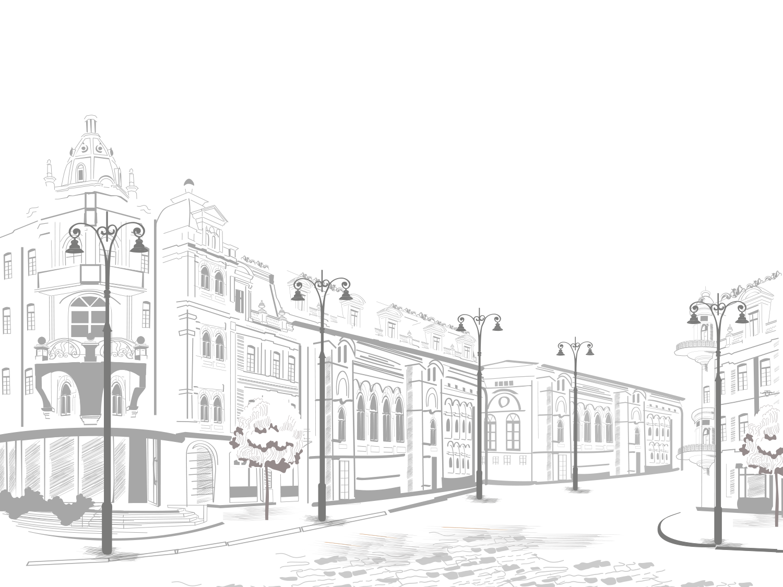
Sights of Great Britain

Slide 2
Westminster Abbey

Slide 3
Westminster Abbey

Slide 4
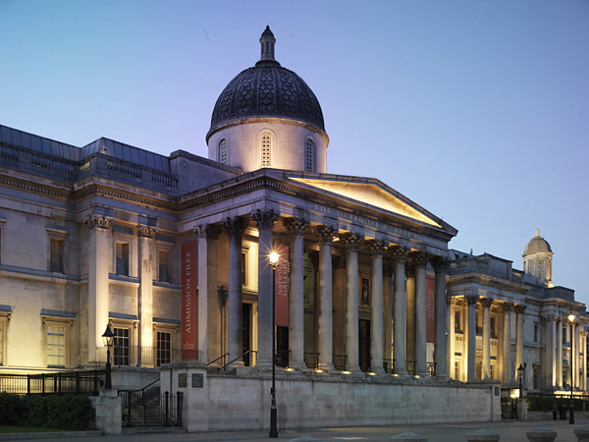
London National Gallery

Slide 5
Madam Tussauds

Slide 6
Buckingham Palace

Slide 7
The Camden Market

Slide 8
The Camden Market

Slide 9
Edinburgh Castle

Slide 10
Harrods Store

Slide 11
London Eye

Slide 12
Piccadilly Circus

Slide 13
Richmond Park

Slide 14
St. Paul’s Cathedral

Slide 15
The Globe Theatre

Slide 16
Stonehenge

Slide 17
Tower of London

Slide 18
Tower Bridge

Slide 19
Trafalgar Square

Slide 20
Westminster Palace Houses of Parliament

Slide 21
Windsor Palace

Slide 22
Windsor Palace

Slide 23
Windsor Palace

Slide 24
Trafalgar Square

Slide 25
The Camden Market

Slide 26
Madam Tussauds

Slide 27
St. Paul’s Cathedral

